Slide 1
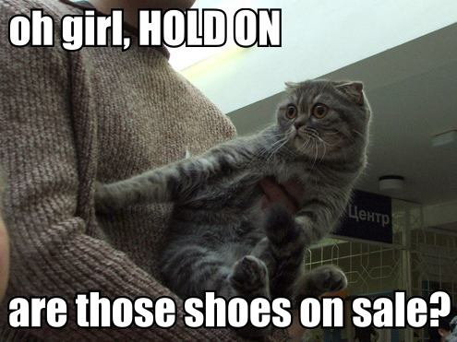

Class Overview

Slide 2

erin’s physical location
Phone: uh, so about Hill Hall
Email: erinbuchanan@missouristate.edu
Office: invisible dimension mars
Skype: aggieerin

Slide 3

Who is this person?
http://aggieerin.com or follow the DOOM lab on Twitter @aggieerin

Slide 4

Who is this person?

Slide 5

Who is this person?

Slide 6

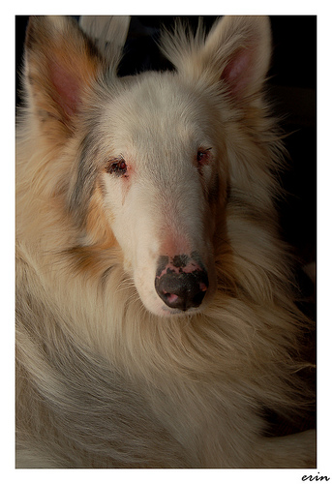
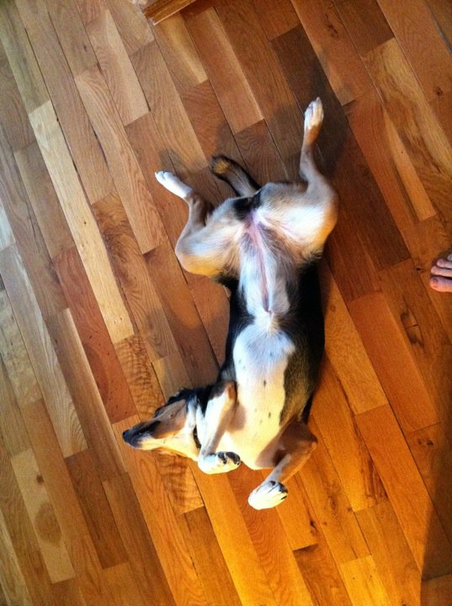
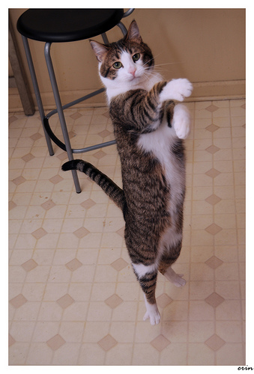
Who is this person?

Slide 7
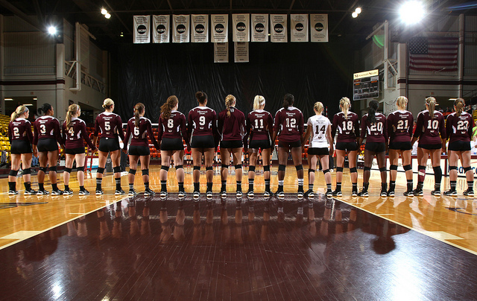
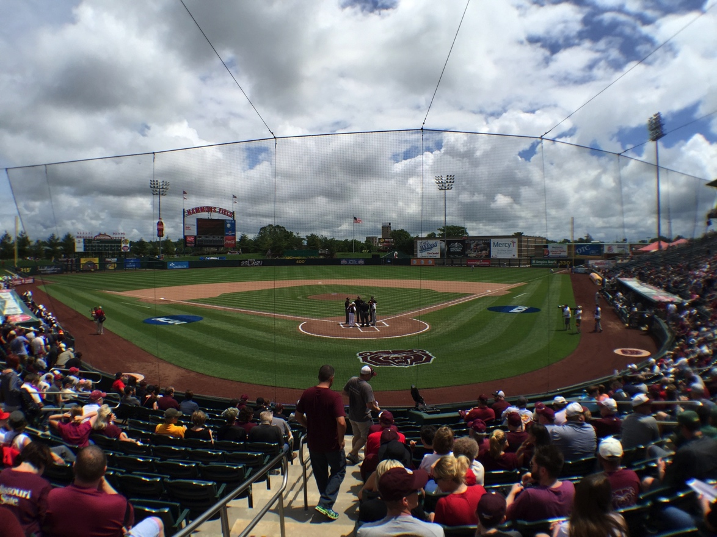


Slide 8

Textbook
Smith and Kosslyn’s Mind and Brain: Cognitive Psychology

Slide 9
How You are Graded
Module discussion boards: 15%
Experiment lab activities: 15%
3 experiment assignment write ups: 15%
3 essay exams: 45%
Research flyer: 10%
Total 100%

Slide 10
How You are Graded
A = 90%; B = 80%; C = 70%; D = 60%; F < 60%
I only use the plus/minus system in a student’s favor.

Slide 11
Discussion Boards
Students will post answers to questions posted on the discussion board (one for each module, select from several questions). You may also comment on other student’s comments. Comments need to be: clear, related to fact/notes/theory, civil, and creative (i.e. don’t just post the notes). Opinions are welcome as long as they do not devolve into “I’m right, you’re wrong, end of story arguments”. Some topics may be related to religious/social morale issues, so any comments containing such information should be respectful of different lifestyles and beliefs.
Grading: Credit/no credit based on the above guidelines.

Slide 12
Experiment Lab Activities
Students will take experiments posted on Blackboard, and post their results in designated places. These results will then be summarized and posted as a discussion board option for students to look at and interpret for write up assignments.
Grading: Credit/no credit based on submitting appropriate numbers.

Slide 13
Experiment Lab Write Ups
For each assignment, answer the following questions:
Definition: What topic was the experiment over? What is that phenomenon (please put this in your own words, I have my slides, do not cut and paste them)?
Results: What were the results from your experiment? (Your score, Classes score from the discussion board, what happened)
Interpretation: What did those results imply? What do they mean?
Application: How might you see this topic in your everyday life?
Grading: You need to answer each question thoroughly and will be graded according to correctness, clarity, and appropriateness of your answers. There are many correct answers.

Slide 14
Essay Exams
For each module, I will provide a list of key terms and phrases (Terms to Know). These terms are designed to help you focus your study for the exam. The exam questions on each test will require you to demonstrate knowledge about an experiment or paradigm that we have discussed in the previous section. To perform well on the exams, you must have a deep understanding of the material, as the short answer and essay questions will be primarily conceptual and application questions, assessing your understanding of how the concepts in this course relate to one another. The exams will cover material since the last exam and will not be cumulative per se, but some topics build on information from earlier in the term and may be required to successfully answer a current question (i.e., questions about expertise, relate to theories of working memory). Concepts that continue to be relevant will be included on the list of terms for the upcoming exam.
Grading: You need to answer each question thoroughly and will be graded according to correctness, clarity, and appropriateness of your answers. There are many correct answers.

Slide 15
Research Flyer
Sometimes the best way to understand research in psychology is to actually read the original research in a particular subject. This project is designed to show you how research might be made interesting to a lay person.

Slide 16
Research Flyer
You will create a “research flyer” for one of the experiments in the article. You can be as creative as you like, using graphics from the article (screen shots of the tables/figures that convey what happened in the experiment).
You can create this flyer as an infographic, flyer like you might see on campus advertising, or other picture/text combinations that display the research you are presenting in a simplified way.

Slide 17
Make Up Policy
This course is very flexible about completing course material on time, since no class presence is required. If you have an emergency, please contact the instructor about extended deadlines. Please be aware that blackboard and the Internet can be fickle/go down for periods of time, but waiting until right before an assignment is due does not constitute an emergency. Open communication with your instructor, along with time management of your course progress, will suit you best for completing this course successfully.

Slide 18
All Other Policies
Listed on the syllabus

Slide 19
Check out the Course Schedule

Slide 20
Late Policy
As described above, you have plenty of time to complete discussion boards/modules/etc. You are expected to contact the instructor if you need extra time due to emergencies or other related events. Discussion boards/experiments will be 50% for late posting and only accepted during the exam section they are tied to. Exams/lab assignments/research flyer are 25% off for each day they are late after the Sunday deadline.

Slide 21
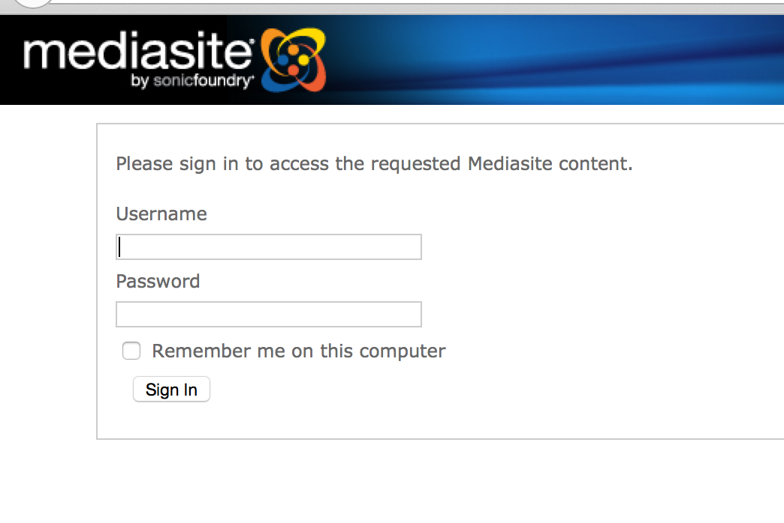
Media Site

Slide 22
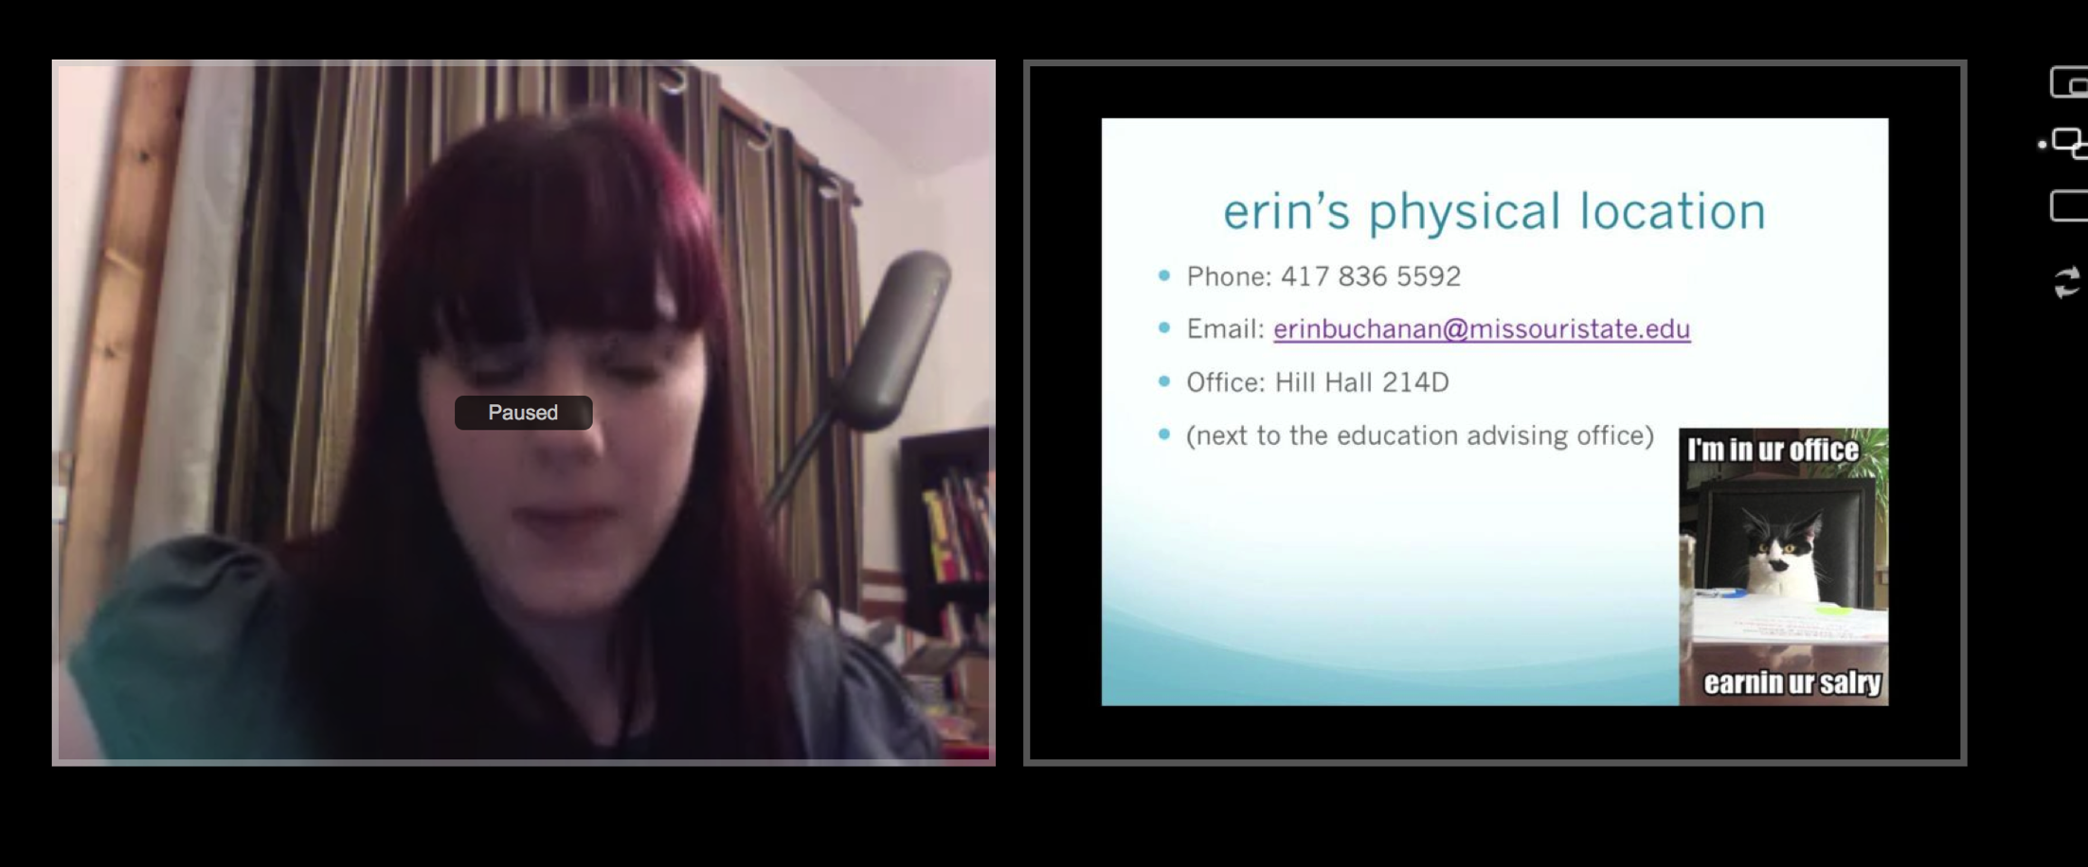

Slide 23
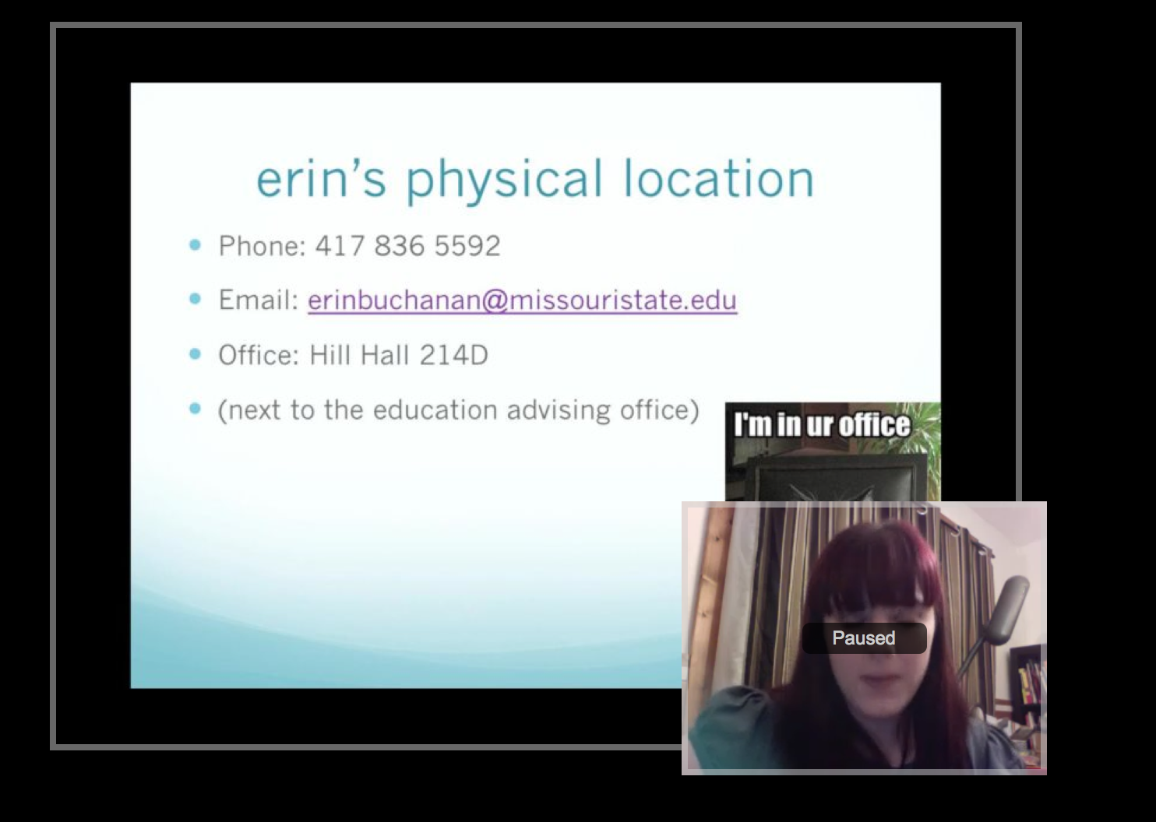

Slide 24
Let’s Check out Blackboard
Where is everything?
How does the stuff work?
How do I turn things in?
Etc.

